Slide 1

Online E-commerce Database Design

Slide 2

Problem Statement

Slide 3
A company called Brivio is a pioneer in designer apparel and has been making a huge revenue through its brick-and-mortar stores.
But, in the last 2 years due to the pandemic, they took a major hit on their revenue as most of their stores were closed, creating an unavailability of their apparel to their customers.
The marketing head of the company approached us with an idea for launching an online store for their products.
They are aiming for a very minimalistic, user-friendly and a comprehensive website and need our help with setting up their Database design and implementation for their website.

Slide 4
The following are the rules must be followed while implementing the database
There are basically two types of customers, regular and exclusive. A customer is identified by unique id and their name (first and last name), email, password_encryption, phone number, gender needs to be captured. Both regular and exclusive customers receive deals personally tailored for them, through their emails and number of deals offered and utilized to be captured
A customer has only one cart and can add any number of items in their cart and save for it later. A cart is identified by a unique ID and the total cost need to be captured. The cart items need to contain the product, and quantity.
The click stream data is collected for the analysis of the marketing team. An event is created every time a customer login.
Each event is identified by a unique id and number of pages visited, number of clicks, time spent in total needs to be captured for that event.

Slide 5
A customer needs to place at least one order and the order needs to have at least one item in it. An order is identified by a unique id and order date, total cost, total tax, total discount, total quantity, shipping date needs to be captured.
The order items need to contain unique products and quantities respectively and the quantity cannot exceed 10 counts for each product .
Each customer can write any number of reviews/suggestions for a particular product regardless of their purchase. These reviews will be utilized for further analysis .
A customer needs to make at least one transaction for the order and each transaction is associated with unique customer .
A transaction is identified by a unique id and status, type needs to be captured.

Slide 6
Each order is fulfilled by only one shipper. Every shipper is identified by a unique id and name, address, email, type needs to be captured. A shipper can take up to deliver any number of orders.
A product is identified by a unique id and its name, description, sku id, ranking, selling price, discount, In/out of stock, size, colors, category, needs to be captured.
A category needs to have at least one product, but a product can belong to only one category. A category is identified by a unique number and its name, description needs to be captured .
A customer can also return any number of items that he/she has purchased in a specific order.
The return table is identified by a return_id and it needs to capture return date, total number of items returned for a particular order.
The return items need to contain unique products and quantities respectively.

Slide 7

the EER diagram for the above database design

Slide 8
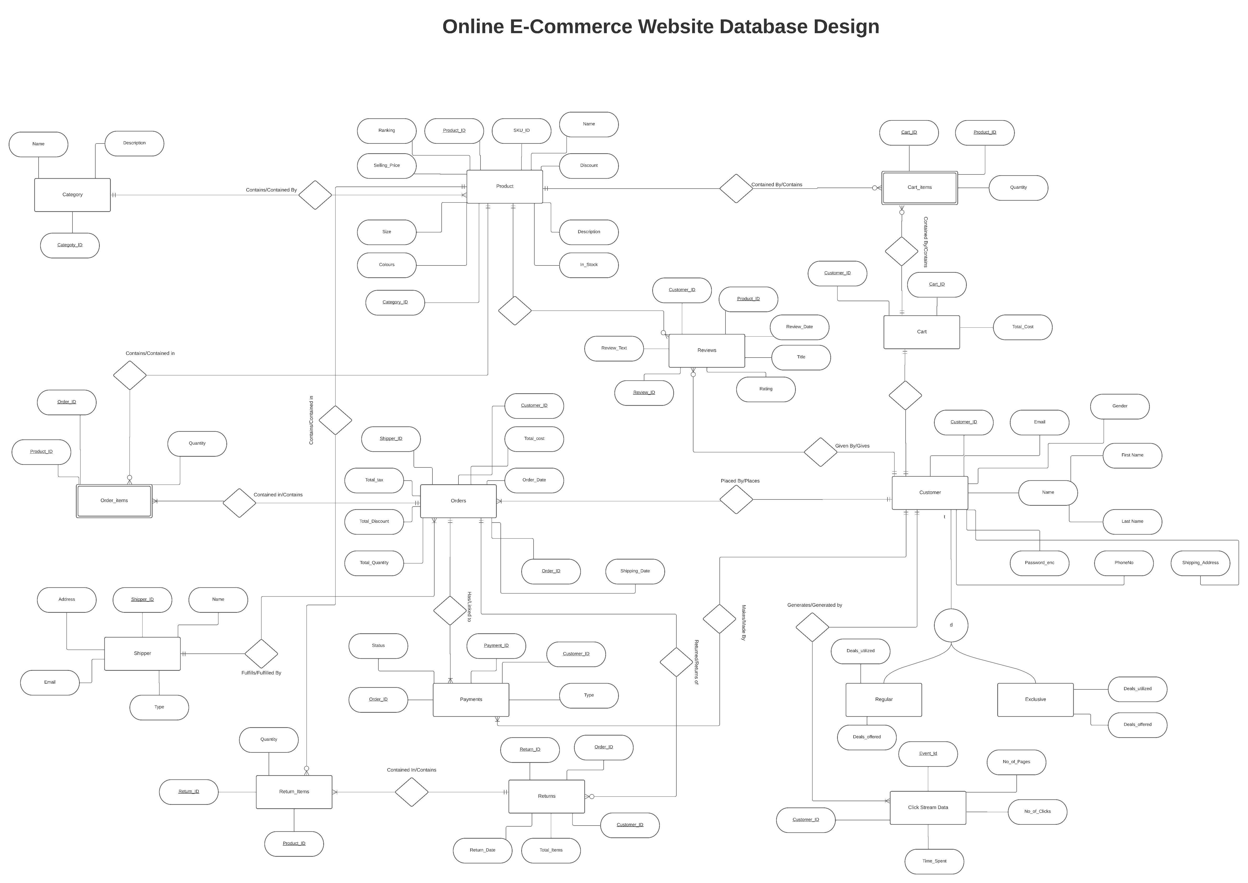

Slide 9
UML diagram for the above database design

Slide 10
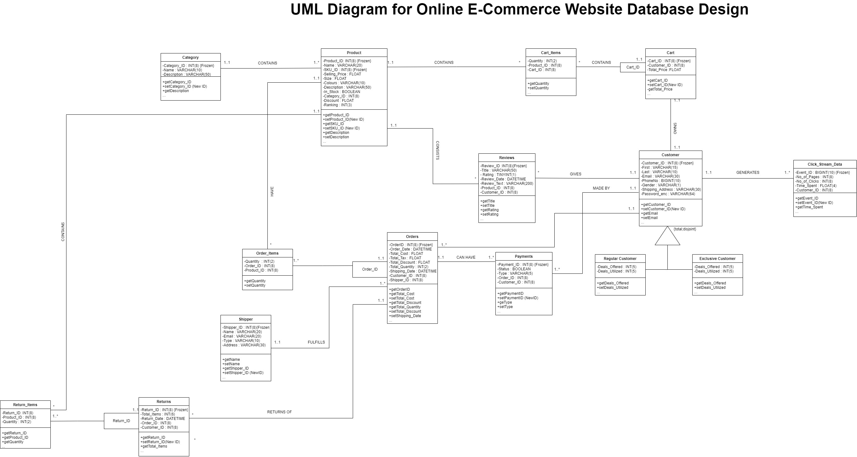

Slide 11

Relational Model for the above database design

Slide 12
Primary Keys are underlined, and foreign keys are mentioned in Italic font
Customer(Customer_ID, First_Name, Last_Name, Email, Gender, Password_enc, PhoneNo, Shipping_Address, Customer_Type, Deals_Utilized, Deals_Offered)
Click_Stream_Data(Event_ID, Customer_ID, No_of_pages, No_of_Clicks, Time_Spent)
Cart(Cart_ID, Customer_ID, Total_Cost)
Cart_Items(Cart_ID, Product_ID, Quantity)
Product(Product_ID, Category_ID, SKU_ID, Name, Ranking, Selling_Price, Discount, Description, In_Stock, Size, Colors)

Slide 13
Category(Category_ID, Name, Description)
Reviews(Review_ID, Customer_ID, Product_ID, Review_Text, Rating, Title, Review_Date)
Orders(Order_ID, Shipper_ID, Customer_ID, Total_Cost, Order_Date, Total_tax, Total_Discount, Total_Quantity,Shipping_Date)
Order_Items(Order_ID, Product_ID, Quantity)
Shipper(Shipper_ID, Address, Name, Email, Type)
Payments(Payment_ID, Customer_ID, Order_ID, Status, Type)
Returns(Return_ID, Order_ID, Customer_ID, Return_Date, Total_Items)
Return_Items(Return_ID, Product_ID, Quantity)

Slide 14

THANK YOU

